Slide 1
CALIFORNIA STATE UNIVERSITY, NORTHRIDGE
The Impact of Economic Indicators on National Income
A graduate project submitted in partial fulfillment of the requirements
For the degree of Master of Science in Business Analytics
By
Ida Karimi
May 2025
Notes:
This study is about impact of economic indicators on national income.

Slide 2
Research Objectives:
Conduct descriptive analytics to examine GDP, GDP growth, foreign investment, inflation rate, and government spending.
Develop predictive analytics models using advanced machine learning methodologies to forecast high-income country classification based on the identified indicators.
Evaluate and compare the effectiveness of machine learning algorithms.
Research Question: Do GDP, GDP growth, foreign investment, inflation rate, and government spending significantly influence national income levels, enabling the application of machine learning techniques to accurately classify countries as high-income based on these indicators?
Notes:
Do GDP, GDP growth, foreign investment, inflation rate, and government spending significantly influence national income levels, enabling the application of machine learning techniques to accurately classify countries as high-income based on these indicators? In this study, descriptive analytics were applied to analyze the economic indicators, and predictive analytics models were developed and meticulously evaluated to address the research question.

Slide 3

Data Collection Process
Data sourced from the World Data Bank.
Includes information covering the years 2021 to 2023.
The World Bank is dedicated to maintaining data quality, as detailed in their framework for evaluating national statistical systems and enhancing data sharing.
Notes:
Data was sourced from the World Data Bank. The data collection process included retrieval of all fields related to the five economic indicators for years 2021 to 2023, development of an Entity-Relationship Diagram which guided the creation of a small database to store the necessary data, and execution of queries to extract relevant data points from the database. Fields with 25% or more missing values were removed to maintain data integrity and fields with fewer missing values were handled using K-Nearest Neighbors imputation techniques. To optimize the dataset for machine learning algorithms, outliers were and standardization was performed using the StandardScaler.

Slide 4
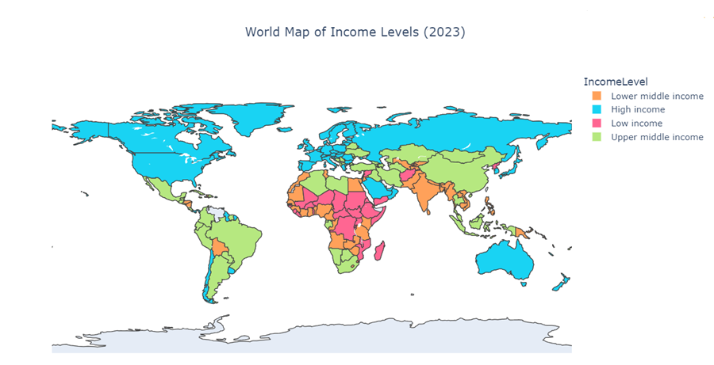
Notes:
According to the World Bank, for the 2025 fiscal year: High-income economies are defined as those with a Gross National Income per capita of $14,005 or more. High-income countries are marked in blue and are predominantly located in regions like North America, Western Europe, Australia, and parts of East Asia.

Slide 5
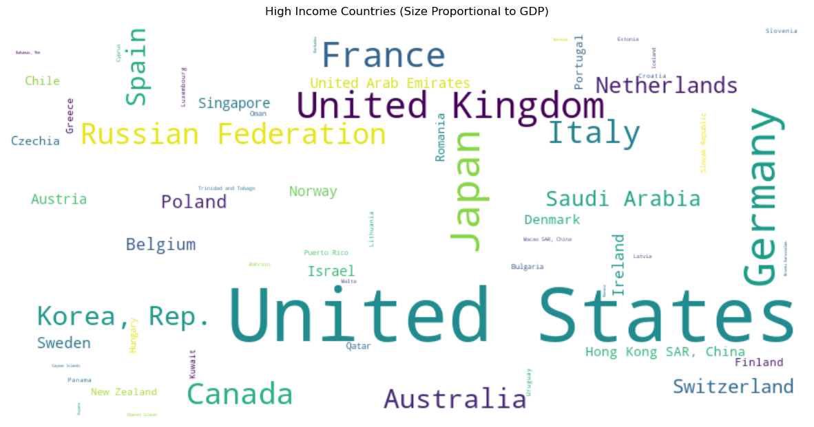
Notes:
To investigate the five indicators—Gross Domestic Product (GDP), GDP growth, foreign investment, inflation rate, and government spending—and examine their influence on economic performance and national income levels, we started by examining how GDP changed from 2021 to 2023 in the top 20 countries with the highest GDP.

Slide 6
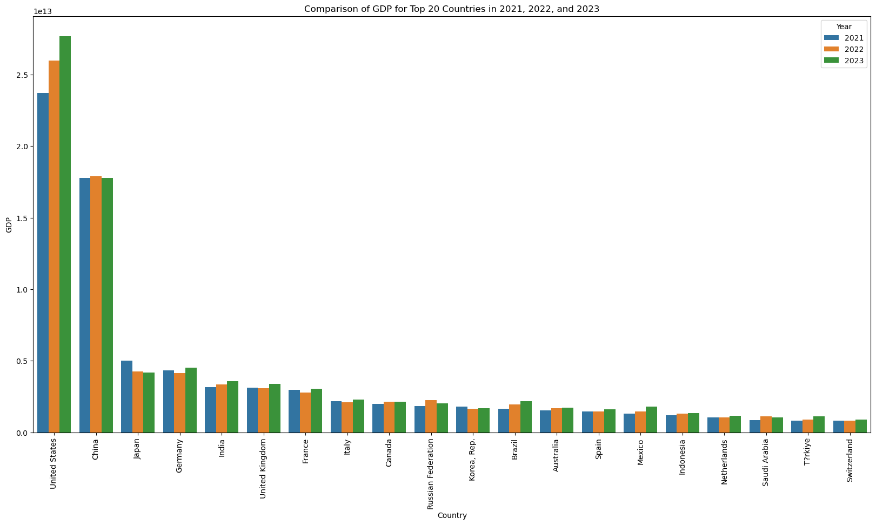
Notes:
The United States dominates, maintaining the highest GDP across all three years. China consistently follows in second place. A statistical analysis was performed to evaluate the difference in GDP between high-income countries and countries in other income groups. The results of the t-test yielded a T-statistic of 2.46 and a P-value of 0.01, indicating a significant difference at the 95% confidence level.

Slide 7
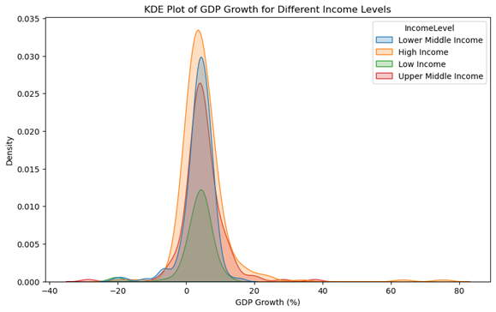
Notes:
This Kernel Density Estimate plot illustrates the distribution of GDP growth rates across four income levels. In the High Income Group, the distribution is more concentrated, with a prominent peak near the moderate GDP growth rate range. This indicates that most high-income countries have stable and predictable GDP growth rates with fewer outliers.

Slide 8
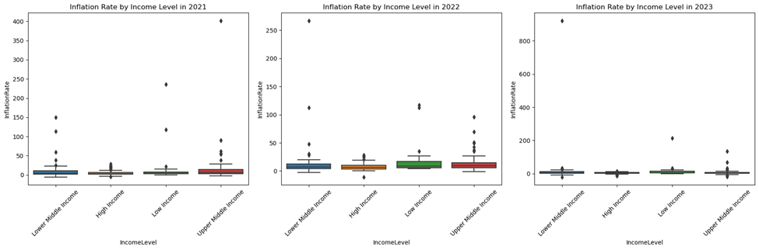
Inflation Rate
A chi-square test was conducted to determine if income level impacts inflation rate.
Chi-square statistic: 13.5686
P-value: 0.0036
Notes:
Higher-income groups experience much lower variability in inflation rates, with fewer outliers. While inflation seems to have affected all income groups, its impact is disproportionately higher for lower-income populations. A chi-square test was conducted to determine if income level impacts inflation rate. The P-value of 0.0036 is much less than 0.05, indicating a statistically significant relationship between income level and inflation rate.

Slide 9
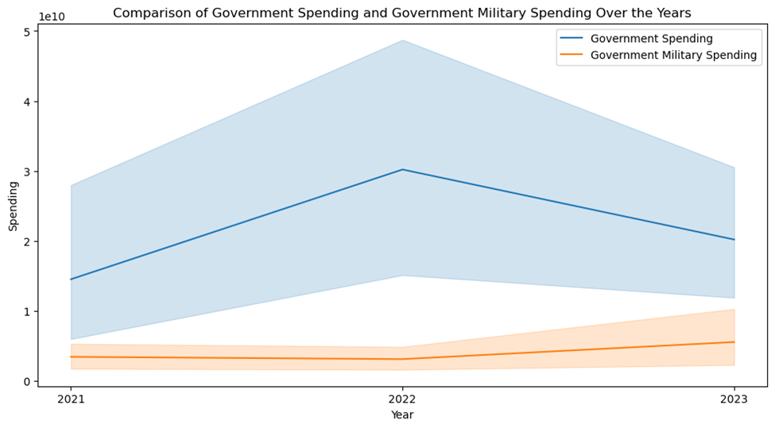
Notes:
Government spending is a key economic indicator that shapes recovery trends, inflation control, and overall financial stability. A significant component of government expenditure is military spending, which plays a crucial role in national security and global influence but also impacts broader economic conditions. Government spending increased sharply in 2022, peaking during economic recovery efforts. However, military spending showed a steady or modest upward trend, indicating continued defense priorities despite shifts in overall fiscal policies.

Slide 10
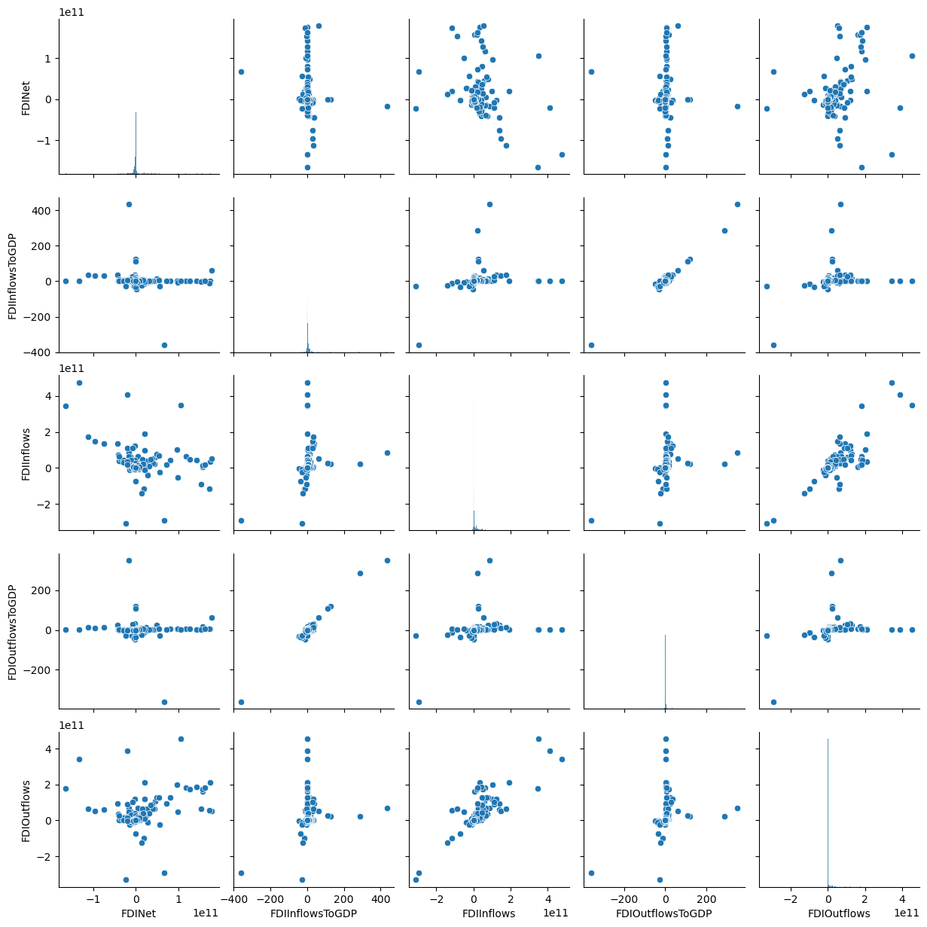
Foreign Direct Investment
Notes:
Another crucial economic indicator to consider is foreign investment, which plays a significant role in driving economic growth, trade opportunities, and financial stability. Foreign investment can bring in capital, technology, and expertise, helping countries strengthen industries, create jobs, and enhance productivity. The graphs indicate varying degrees of correlation among foreign direct investment (FDI) indicators. Some relationships appear more structured, while others display significant dispersion, suggesting weak associations between certain metrics. Countries with higher FDI inflows generally show proportionate FDI outflows, reflecting the interconnected nature of global investment flows.

Slide 11
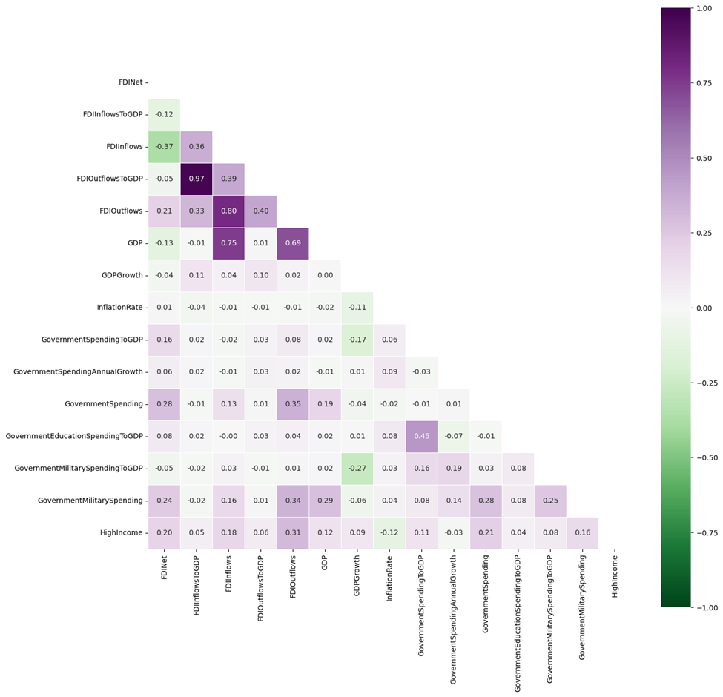
Correlation Heatmap
Notes:
This heatmap visualizes the pairwise correlations between all numeric variables used in this study. Using machine learning models, we aim to determine whether GDP, GDP growth, foreign investment, inflation rate, and government spending significantly influence national income levels, enabling us to accurately classify countries as high-income based on these indicators.

Slide 12
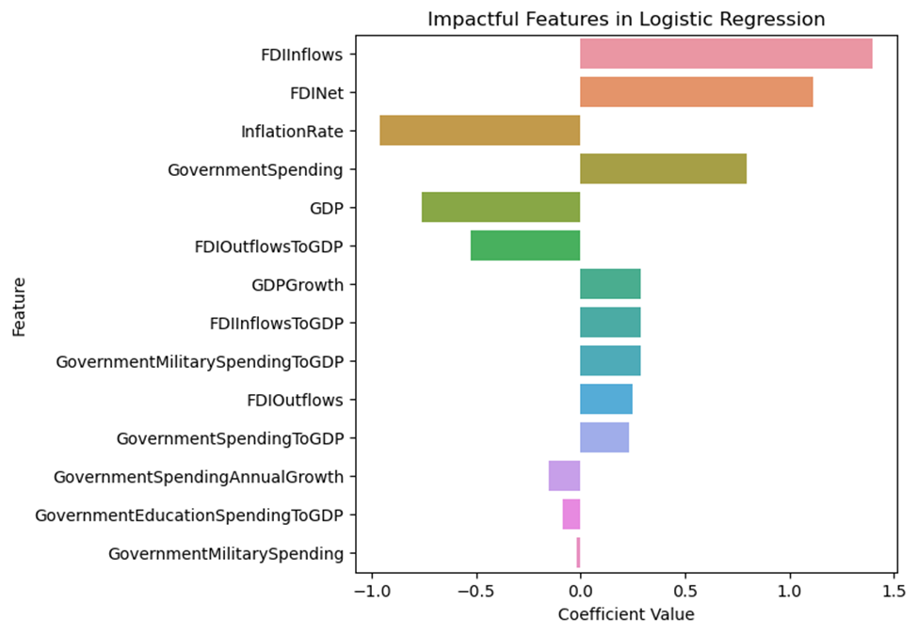
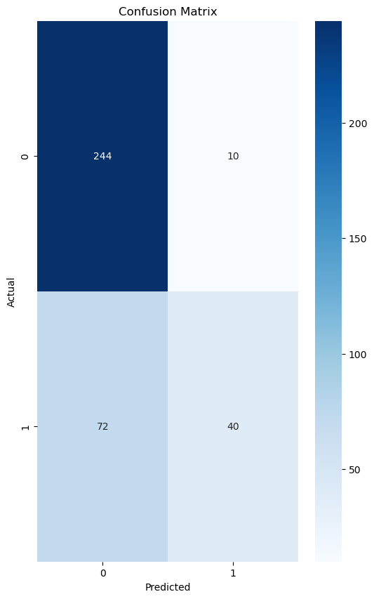
Logistic Regression
Notes:
A logistic regression model was developed using k-fold cross-validation to assess whether economic indicators can predict high-income countries. The model was tested across multiple folds, producing cross-validation accuracy scores with an average accuracy of 0.78. The accuracy values remain relatively stable across different training and validation sets, indicating that the model generalizes well to new data. The model correctly predicted 244 instances as non-high-income countries (true negatives) and 40 instances as high-income countries (true positives). However, there were 72 false negatives, meaning some high-income countries were misclassified as lower-income, and 10 false positives, where the model mistakenly classified lower-income countries as high-income. Features such as FDI inflows, FDI net, and government spending have positive coefficients, suggesting that higher values of these indicators make a country more likely to be classified as high-income.

Slide 13
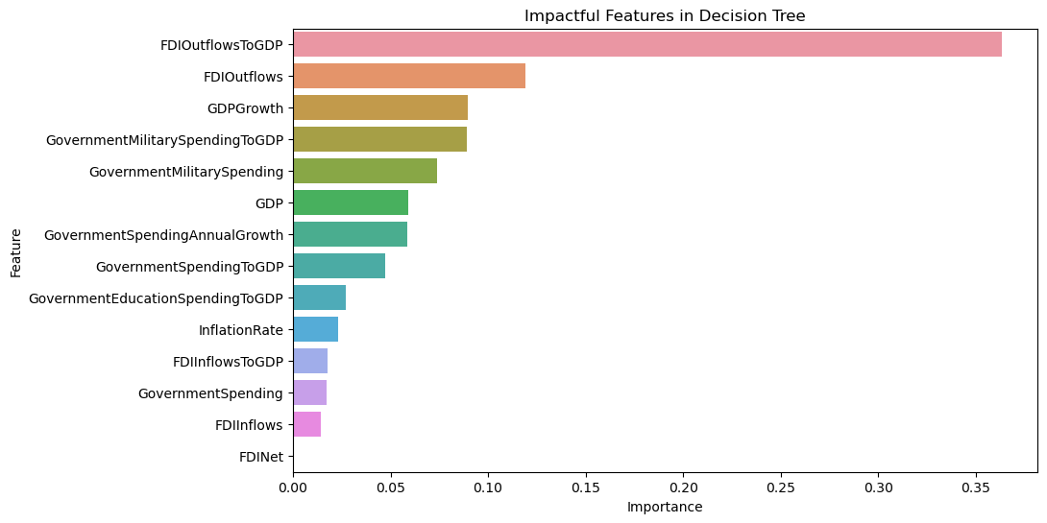
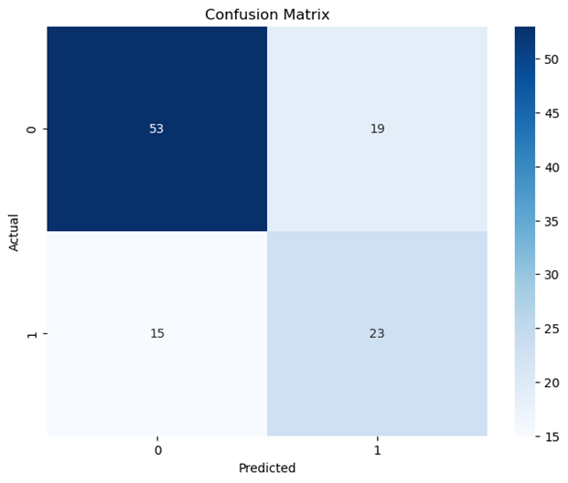
Decision Tree
Notes:
A decision tree model was developed for the same investigation. The model achieved an accuracy of 69%, indicating moderate predictive power. The confusion matrix reveals that the model correctly identified 53 non-high-income countries (true negatives) and 23 high-income countries (true positives). However, there were 19 false positives, where lower-income countries were mistakenly classified as high-income, and 15 false negatives, where high-income nations were misclassified. The decision tree’s accuracy of 69% is lower than the logistic regression model’s 78% accuracy, suggesting that logistic regression might be more effective for this classification task. Here FDI Outflows to GDP is the most influential feature, suggesting that the scale of foreign direct investment (FDI) outflows relative to GDP strongly contributes to classifying a country as high-income.

Slide 14
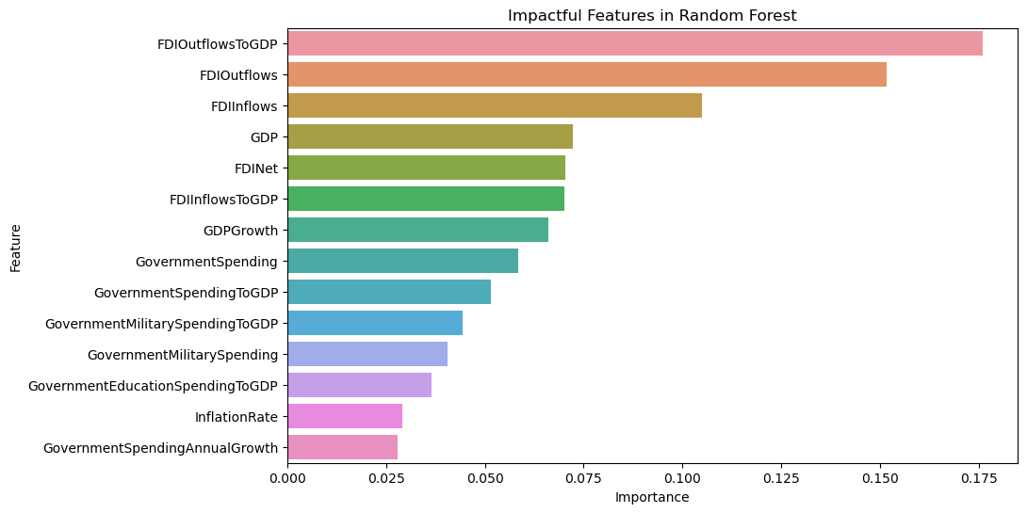
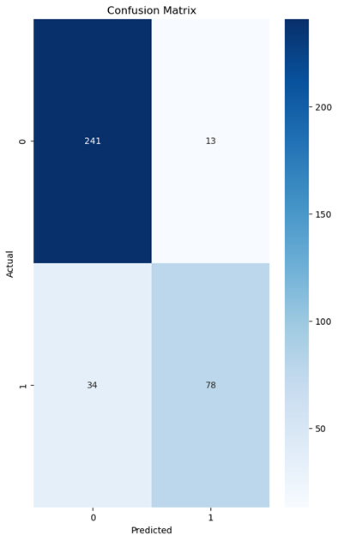
Random Forest
Notes:
The next model developed for this investigation was a Random Forest classifier, designed to improve predictive accuracy and generalization compared to previous models. The model achieved perfect accuracy on the training data, indicating that it learned patterns effectively. However, this could also suggest possible overfitting. The model also maintained strong performance on unseen data, achieving 83.6% accuracy, an improvement over the previous decision tree model and outperforming logistic regression. The model successfully classified 241 non-high-income countries, correctly identifying them based on economic indicators. Additionally, it accurately predicted 78 high-income countries, demonstrating strong classification performance. However, there were 13 false positives, where lower-income nations were mistakenly categorized as high-income, and 34 false negatives, where high-income countries were misclassified as non-high-income. The most impactful feature in the Random Forest model is FDI Outflows to GDP, emphasizing that countries with substantial outbound investments tend to be high-income.

Slide 15
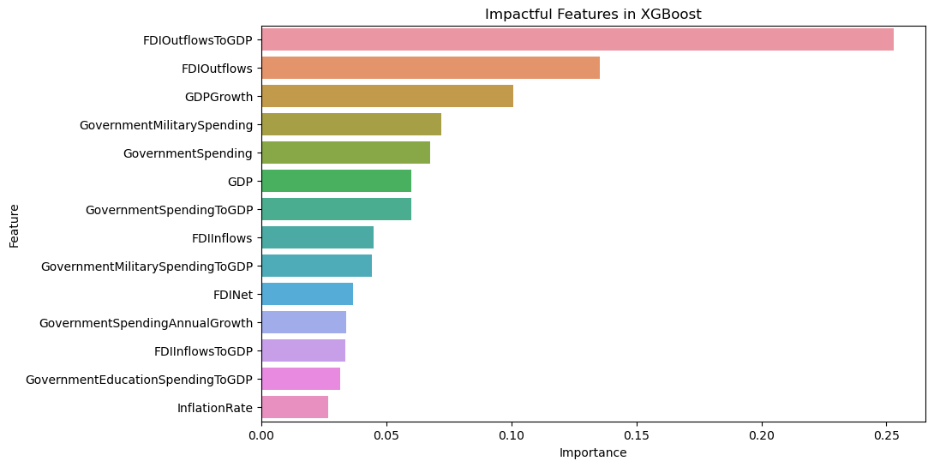
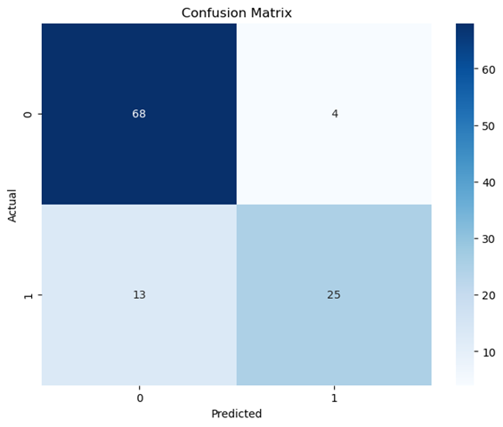
XG Boost
Notes:
The next model developed for this investigation was XGBoost, a powerful gradient boosting algorithm designed to enhance classification performance. The model achieved a test accuracy of 84.5%, surpassing previous models and demonstrating strong predictive capability. The XGBoost model correctly classified 68 non-high-income countries (true negatives) and 25 high-income countries (true positives). However, 4 lower-income countries were misclassified as high-income (false positives), while 13 high-income nations were mistakenly categorized as non-high-income (false negatives). FDI Outflows to GDP is the most influential feature, reinforcing the idea that outbound foreign investment strongly correlates with high-income classification.

Slide 16
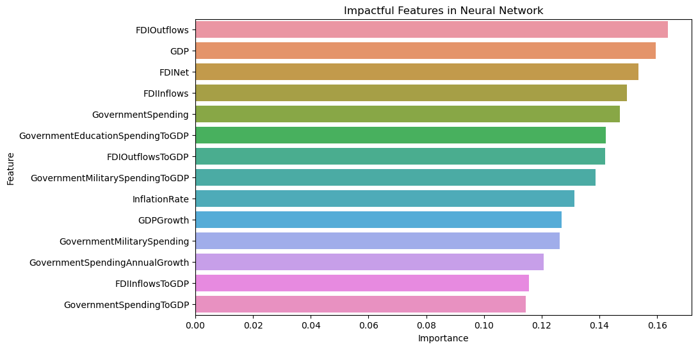
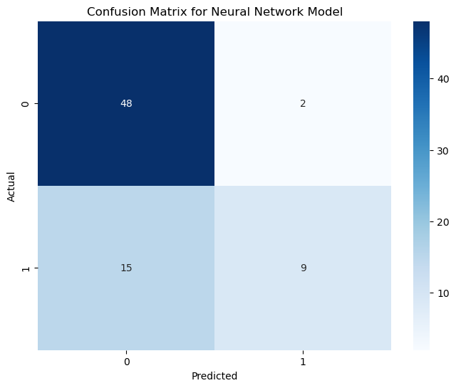
Neural Network
Notes:
A neural network model was developed to assess whether it could more effectively predict high-income countries based on economic indicators. The model achieved an accuracy of 77% to the logistic regression model (78%). The model correctly classified 48 non-high-income countries (true negatives) and 9 high-income countries (true positives), demonstrating reasonable predictive accuracy. However, 2 lower-income countries were misclassified as high-income (false positives), while 15 high-income nations were incorrectly categorized as non-high-income (false negatives). The most impactful feature influencing the neural network’s predictions are FDI Outflows and GDP.

Slide 17
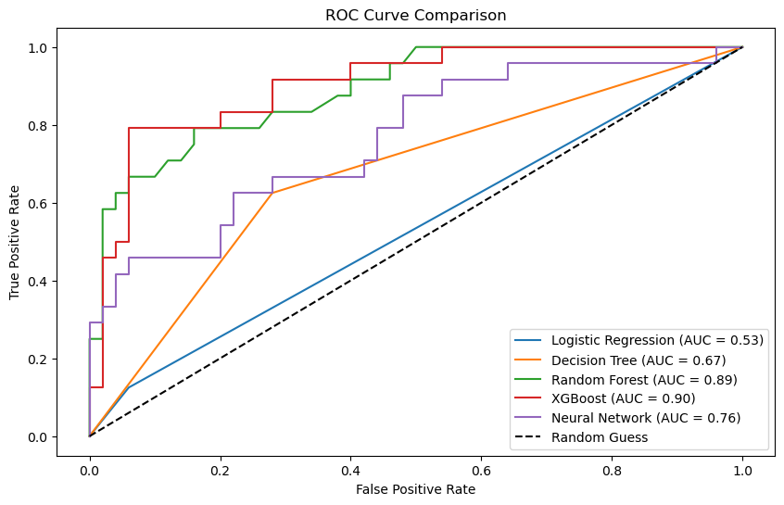
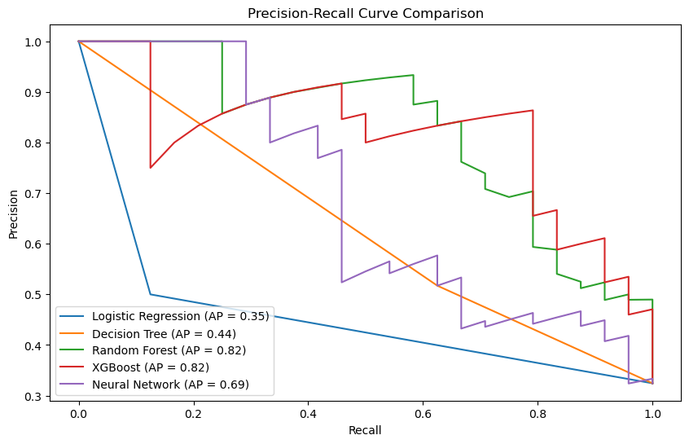
Models Comparison
+---------------------+-------+-------------------+
| Model | AUC | Average Precision |
+---------------------+-------+-------------------+
| Logistic Regression | 0.532 | 0.346 |
| Decision Tree | 0.672 | 0.445 |
| Random Forest | 0.889 | 0.824 |
| XGBoost | 0.903 | 0.817 |
| Neural Network | 0.763 | 0.691 |
+---------------------+-------+-------------------+
Notes:
ROC curve illustrates a classification model’s performance across all classification thresholds, with True Positive Rate plotted against False Positive Rate. The Random Guess baseline (dashed line) represents an AUC of 0.5, meaning models performing near this level aren’t much better than random chance. XGBoost has the highest Area Under this Curve, making it the best-performing model in this comparison. Precision-Recall Curve illustrates the trade-off between precision (how often positive predictions are correct) and recall (how many actual positives are identified). Random Forest and XGBoost both demonstrate strong precision and recall, achieving an AP of 0.82, making them the top-performing models. These results demonstrate that machine learning models can effectively predict whether countries fall into the high-income category based on examined key economic indicators.

Slide 18
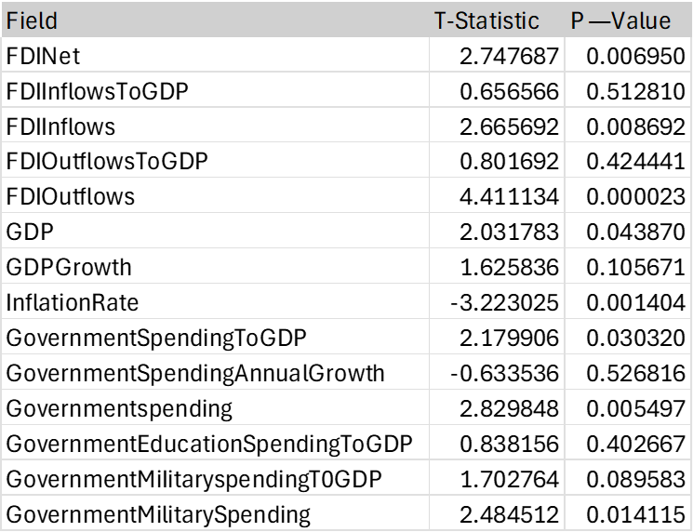
Economic Indicators and High-Income Status
Notes:
This table presents the results of t-tests analyzing the relationship between economic indicators and high-income status. The T-Statistic quantifies the strength of the relationship and the P-Value determines statistical significance. A higher absolute t-value (e.g., greater than 2 or less than -2) suggests stronger evidence against the null hypothesis. The p-value tells the probability of obtaining results at least as extreme as those observed, assuming the null hypothesis is true. The result is typically considered statistically significant when p is less than 0.05, meaning there’s strong evidence to reject the null hypothesis.

Slide 19
Conclusion
• Descriptive analytics were conducted to analyze the economic indicators, including GDP, GDP growth, foreign investment, inflation rate, and government spending.
• Predictive analytics models, such as XGBoost and Random Forest, achieved predictive accuracies of 84.5% and 83.6%, respectively.
• Foreign direct investment emerged as a significant determinant of high-income classification.
• High-income countries demonstrated stable inflation rates and robust investment flows, emphasizing the importance of macroeconomic stability.
• Future research should address the limitations of missing World Bank data (2021–2023) and expand datasets to include granular indicators like employment levels, labor productivity, and sector-specific investment flows.
Notes:
This study successfully demonstrated that key economic indicators—Gross Domestic Product (GDP), GDP growth, foreign investment, inflation rate, and government spending—significantly impact national income classification. Using machine learning methodologies, models such as XGBoost and Random Forest emerged as the most effective, achieving predictive accuracies of 84.5% and 83.6%, respectively. The results highlighted the importance of foreign direct investment (FDI), particularly FDI outflows, as a critical factor in determining high-income status. Given the limitations of missing economic data from the World Bank for the years 2021–2023, future research should focus on expanding datasets to enhance predictive accuracy. Including additional years and more granular economic indicators, such as employment levels, labor productivity, and sector-specific investment flows, could improve the robustness of classification models.

